Slide 1
Nehemiah- Finale
Promises, Promises, Promises…
Richard Brown
Notes:
Introduction
Over the last several weeks we have been studying the story of Nehemiah and I trust you have learned much from it.
I can’t recap on each and every preach we’ve had over the last few weeks; I encourage you to go back over your notes. You will hopefully remember that Nehemiah’s heart was broken for the plight of his nation; he leaves the safety and comfort of his service in Persia and bravely steps up to the task of getting the nation of Israel back on track. He made an honest assessment of the problem, got everyone involved, dealt with external opposition and internal issues and led the people towards a great revival, where they made several promises/vows to obey God.

Slide 2
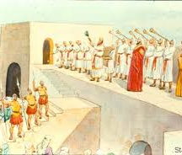
The build up to the Finale
Many of the people return to their home towns
Nehemiah dedicates the wall to God
Nehemiah returns to Persia
BUT…
The nation of Israel starts to lose its way again!
Nehemiah asks for permission to return to Jerusalem
Notes:
So it falls on me to try and wrap up this study as we come to the closing chapters 11-13. There is too much here to read it all, so I will just pull out certain parts that I feel we should focus in on.
In chapters 11-12, after the people had recommitted their lives to following God, Nehemiah helps to people to decide who is going to remain in Jerusalem, and who would return to their home towns around Judah (1 tenth of the people remained in Jerusalem – an interesting number).
Once this had all been sorted Nehemiah brings everyone together for one final celebration as they dedicate the wall to God. This was a huge celebration with lots of music and singing, much of this taking place on top of the walls so that those far and wide would see and hear of the revival of God’s people.
So, by the time we get to the final chapter of this book, things are amazing; a real mountain top experience for the people of God.
At some point during this time Nehemiah returns to Persia to continue in his service to the king. Whilst he is away things seem to start to go downhill. We don’t know how long Nehemiah is away for, but I can only assume, like before, that he hears that things are not going well and he asks for permission to return to Jerusalem.
We’re now going to pick up the story in Nehemiah 13, but before we do that I want to remind us all of the promises that the Israelites make back in chapter 10.

Slide 3
Promises, Promises, Promises
Not give their sons or daughters in marriage to people of other religions. (v. 30)
Not do business with the neighbouring people groups on the Sabbath. (v. 31)
Give money towards the Temple needs. (v. 32-33)
Have the priests and Levites alternate their work. (v. 34)
Bring the first fruits of their crops to the Temple. (v. 35)
Bring the first born of their sons and cattle to the Temple for consecration. (v. 36)
Bring the first of their food supplies and their tithes to fill the storehouses of the Temple treasury. (v. 37-39)
Not neglect the house of God. (v. 39)
Notes:
Promises, Promises, Promises
Not give their sons or daughters in marriage to people of other religions. (v. 30)
Not do business with the neighbouring people groups on the Sabbath. (v. 31)
Give money towards the Temple needs. (v. 32-33)
Have the priests and Levites alternate their work. (v. 34)
Bring the first fruits of their crops to the Temple. (v. 35)
Bring the first born of their sons and cattle to the Temple for consecration. (v. 36)
Bring the first of their food supplies and their tithes to fill the storehouses of the Temple treasury. (v. 37-39)
Not neglect the house of God. (v. 39)
These are great promises and certainly demonstrated the desire of God’s people to get themselves right before God.
As we now read through chapter 13, see if you can identify which of these promises get broken.

Slide 4
Nehemiah 13
New Living Translation
¹ On that same day, as the Book of Moses was being read to the people, the passage was found that said no Ammonite or Moabite should ever be permitted to enter the assembly of God. ² For they had not provided the Israelites with food and water in the wilderness. Instead, they hired Balaam to curse them, though our God turned the curse into a blessing. ³ When this passage of the Law was read, all those of foreign descent were immediately excluded from the assembly.
Notes:
Nehemiah 13
13 On that same day, as the Book of Moses was being read to the people, the passage was found that said no Ammonite or Moabite should ever be permitted to enter the assembly of God.[a] ² For they had not provided the Israelites with food and water in the wilderness. Instead, they hired Balaam to curse them, though our God turned the curse into a blessing. ³ When this passage of the Law was read, all those of foreign descent were immediately excluded from the assembly.

Slide 5
Nehemiah 13
New Living Translation
⁴ Before this had happened, Eliashib the priest, who had been appointed as supervisor of the storerooms of the Temple of our God and who was also a relative of Tobiah, ⁵ had converted a large storage room and placed it at Tobiah’s disposal. The room had previously been used for storing the grain offerings, the frankincense, various articles for the Temple, and the tithes of grain, new wine, and olive oil (which were prescribed for the Levites, the singers, and the gatekeepers), as well as the offerings for the priests.
Notes:
Nehemiah 13
⁴ Before this had happened, Eliashib the priest, who had been appointed as supervisor of the storerooms of the Temple of our God and who was also a relative of Tobiah, ⁵ had converted a large storage room and placed it at Tobiah’s disposal. The room had previously been used for storing the grain offerings, the frankincense, various articles for the Temple, and the tithes of grain, new wine, and olive oil (which were prescribed for the Levites, the singers, and the gatekeepers), as well as the offerings for the priests.

Slide 6
Nehemiah 13
New Living Translation
⁶ I was not in Jerusalem at that time, for I had returned to King Artaxerxes of Babylon in the thirty-second year of his reign, though I later asked his permission to return. ⁷ When I arrived back in Jerusalem, I learned about Eliashib’s evil deed in providing Tobiah with a room in the courtyards of the Temple of God. ⁸ I became very upset and threw all of Tobiah’s belongings out of the room. ⁹ Then I demanded that the rooms be purified, and I brought back the articles for God’s Temple, the grain offerings, and the frankincense.
Notes:
Nehemiah 13
⁶ I was not in Jerusalem at that time, for I had returned to King Artaxerxes of Babylon in the thirty-second year of his reign,^{[b]} though I later asked his permission to return. ⁷ When I arrived back in Jerusalem, I learned about Eliashib’s evil deed in providing Tobiah with a room in the courtyards of the Temple of God. ⁸ I became very upset and threw all of Tobiah’s belongings out of the room. ⁹ Then I demanded that the rooms be purified, and I brought back the articles for God’s Temple, the grain offerings, and the frankincense.

Slide 7
Nehemiah 13
New Living Translation
¹⁰ I also discovered that the Levites had not been given their prescribed portions of food, so they and the singers who were to conduct the worship services had all returned to work their fields. ¹¹ I immediately confronted the leaders and demanded, “Why has the Temple of God been neglected?” Then I called all the Levites back again and restored them to their proper duties. ¹² And once more all the people of Judah began bringing their tithes of grain, new wine, and olive oil to the Temple storerooms.
Notes:
Nehemiah 13
¹⁰ I also discovered that the Levites had not been given their prescribed portions of food, so they and the singers who were to conduct the worship services had all returned to work their fields. ¹¹ I immediately confronted the leaders and demanded, “Why has the Temple of God been neglected?” Then I called all the Levites back again and restored them to their proper duties. ¹² And once more all the people of Judah began bringing their tithes of grain, new wine, and olive oil to the Temple storerooms.

Slide 8
Nehemiah 13
New Living Translation
¹³ I assigned supervisors for the storerooms: Shelemiah the priest, Zadok the scribe, and Pedaiah, one of the Levites. And I appointed Hanan son of Zaccur and grandson of Mattaniah as their assistant. These men had an excellent reputation, and it was their job to make honest distributions to their fellow Levites.
¹⁴ Remember this good deed, O my God, and do not forget all that I have faithfully done for the Temple of my God and its services.
Notes:
Nehemiah 13
¹³ I assigned supervisors for the storerooms: Shelemiah the priest, Zadok the scribe, and Pedaiah, one of the Levites. And I appointed Hanan son of Zaccur and grandson of Mattaniah as their assistant. These men had an excellent reputation, and it was their job to make honest distributions to their fellow Levites.
¹⁴ Remember this good deed, O my God, and do not forget all that I have faithfully done for the Temple of my God and its services.

Slide 9
Nehemiah 13
New Living Translation
¹⁵ In those days I saw men of Judah treading out their winepresses on the Sabbath. They were also bringing in grain, loading it on donkeys, and bringing their wine, grapes, figs, and all sorts of produce to Jerusalem to sell on the Sabbath. So I rebuked them for selling their produce on that day. ¹⁶ Some men from Tyre, who lived in Jerusalem, were bringing in fish and all kinds of merchandise. They were selling it on the Sabbath to the people of Judah—and in Jerusalem at that!
Notes:
Nehemiah 13
¹⁵ In those days I saw men of Judah treading out their winepresses on the Sabbath. They were also bringing in grain, loading it on donkeys, and bringing their wine, grapes, figs, and all sorts of produce to Jerusalem to sell on the Sabbath. So I rebuked them for selling their produce on that day. ¹⁶ Some men from Tyre, who lived in Jerusalem, were bringing in fish and all kinds of merchandise. They were selling it on the Sabbath to the people of Judah—and in Jerusalem at that!

Slide 10
Nehemiah 13
New Living Translation
¹⁷ So I confronted the nobles of Judah. “Why are you profaning the Sabbath in this evil way?” I asked. ¹⁸ “Wasn’t it just this sort of thing that your ancestors did that caused our God to bring all this trouble upon us and our city? Now you are bringing even more wrath upon Israel by permitting the Sabbath to be desecrated in this way!” ¹⁹ Then I commanded that the gates of Jerusalem should be shut as darkness fell every Friday evening, not to be opened until the Sabbath ended. I sent some of my own servants to guard the gates so that no merchandise could be brought in on the Sabbath day.
Notes:
Nehemiah 13
¹⁷ So I confronted the nobles of Judah. “Why are you profaning the Sabbath in this evil way?” I asked. ¹⁸ “Wasn’t it just this sort of thing that your ancestors did that caused our God to bring all this trouble upon us and our city? Now you are bringing even more wrath upon Israel by permitting the Sabbath to be desecrated in this way!” ¹⁹ Then I commanded that the gates of Jerusalem should be shut as darkness fell every Friday evening, not to be opened until the Sabbath ended. I sent some of my own servants to guard the gates so that no merchandise could be brought in on the Sabbath day.

Slide 11
Nehemiah 13
New Living Translation
²⁰ The merchants and tradesmen with a variety of wares camped outside Jerusalem once or twice. ²¹ But I spoke sharply to them and said, “What are you doing out here, camping around the wall? If you do this again, I will arrest you!” And that was the last time they came on the Sabbath. ²² Then I commanded the Levites to purify themselves and to guard the gates in order to preserve the holiness of the Sabbath.
Remember this good deed also, O my God! Have compassion on me according to your great and unfailing love.
Notes:
Nehemiah 13
²⁰ The merchants and tradesmen with a variety of wares camped outside Jerusalem once or twice. ²¹ But I spoke sharply to them and said, “What are you doing out here, camping around the wall? If you do this again, I will arrest you!” And that was the last time they came on the Sabbath. ²² Then I commanded the Levites to purify themselves and to guard the gates in order to preserve the holiness of the Sabbath.
Remember this good deed also, O my God! Have compassion on me according to your great and unfailing love.

Slide 12
Nehemiah 13
New Living Translation
²³ About the same time I realized that some of the men of Judah had married women from Ashdod, Ammon, and Moab. ²⁴ Furthermore, half their children spoke the language of Ashdod or of some other people and could not speak the language of Judah at all. ²⁵ So I confronted them and called down curses on them. I beat some of them and pulled out their hair. I made them swear in the name of God that they would not let their children intermarry with the pagan people of the land.
Notes:
Nehemiah 13
²³ About the same time I realized that some of the men of Judah had married women from Ashdod, Ammon, and Moab. ²⁴ Furthermore, half their children spoke the language of Ashdod or of some other people and could not speak the language of Judah at all. ²⁵ So I confronted them and called down curses on them. I beat some of them and pulled out their hair. I made them swear in the name of God that they would not let their children intermarry with the pagan people of the land.

Slide 13
Nehemiah 13
New Living Translation
²⁶ “Wasn’t this exactly what led King Solomon of Israel into sin?” I demanded. “There was no king from any nation who could compare to him, and God loved him and made him king over all Israel. But even he was led into sin by his foreign wives. ²⁷ How could you even think of committing this sinful deed and acting unfaithfully toward God by marrying foreign women?” ²⁸ One of the sons of Joiada son of Eliashib the high priest had married a daughter of Sanballat the Horonite, so I banished him from my presence.
Notes:
Nehemiah 13
²⁶ “Wasn’t this exactly what led King Solomon of Israel into sin?” I demanded. “There was no king from any nation who could compare to him, and God loved him and made him king over all Israel. But even he was led into sin by his foreign wives. ²⁷ How could you even think of committing this sinful deed and acting unfaithfully toward God by marrying foreign women?”
²⁸ One of the sons of Joiada son of Eliashib the high priest had married a daughter of Sanballat the Horonite, so I banished him from my presence.

Slide 14
Nehemiah 13
New Living Translation
²⁹ Remember them, O my God, for they have defiled the priesthood and the solemn vows of the priests and Levites.
³⁰ So I purged out everything foreign and assigned tasks to the priests and Levites, making certain that each knew his work. ³¹ I also made sure that the supply of wood for the altar and the first portions of the harvest were brought at the proper times.
Remember this in my favour, O my God.
Notes:
Nehemiah 13
²⁹ Remember them, O my God, for they have defiled the priesthood and the solemn vows of the priests and Levites.
³⁰ So I purged out everything foreign and assigned tasks to the priests and Levites, making certain that each knew his work. ³¹ I also made sure that the supply of wood for the altar and the first portions of the harvest were brought at the proper times.
Remember this in my favour, O my God.

Slide 15
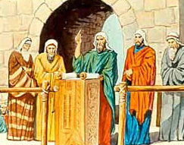
Key points to take away
It’s easy to make promises, it’s much harder to keep them
We need to stop compromising over things we know are wrong
If we want to persevere in the things of God, we need the Holy Spirit
Notes:
We’re going to walk back through this chapter as and we do I want to make the following points:
It’s easy to make promises, it’s much harder to keep them
We stop need to stop compromising over things we know are wrong
If we want to persevere in the things of God, we need the Holy Spirit

Slide 16
It’s easy to make Promises, it’s much harder to keep them
v4-9 Eliashib neglected of the house of God
v10 The people stopped bringing their tithes and offerings leading to the Levites stopping their worship and returning to their homes
v15 People working on the Sabbath and trading with foreigners on the Sabbath.
v23 People inter-marrying with pagan nations
This infiltration of pagan practices affected home, work and worship
Notes:
It’s easy to make promises, it’s much harder to keep them
Did you notice how many of people’s promises had been broken?
In verse 4-9 we learn that Eliashib the priest (or high priest) had converted a large storage room used for tithes and offerings and other temple articles, and had given it to Tobiah for his own personal use. Do you remember Tobiah? He was an Ammonite who, along with Sanballat, tried every which way to oppose the rebuilding of the city walls. Why did he allow Tobiah space in the temple? A possible clue can be found further down in the chapter in verse 28 where we find that Eliashib’s gandson had married one of the daughters of Sanballat. Not a marriage I think God would have approved of.
To make matters worse Nehemiah discovers in verse 10 that people had stopped bringing in their tithes and offerings meaning that the Levites who were meant to be conducting worship were not receiving their allocation of food. So worship stopped and the Levites returned to their fields. This may well have been linked to Tobiah taking over the storeroom.
Then in verse 15 Nehemiah discovers people working the winepresses on the Sabbath, other people bring food produce into Jerusalem to sell on the Sabbath and even trading with foreigners on the Sabbath.
Worst of all, in verse 23 we see that God’s people had gone back to their old practices of inter-marrying with the surrounding pagan nations, one of which we’ve already mentioned who was amongst the priests. This meant that half of the children in these families couldn’t speak the native Hebrew language.
It seems to be that we can pretty well assume most, if not all their promises, had been broken and this infiltration of pagan practices was affecting home life, work life, and temple life (worship).

Slide 17
It’s easy to make promises, it’s much harder to keep them
It’s one thing to make promises on the mountain tops; keeping those promises in the valleys of day to day living can be much harder
Promises turn into compromises and before we know it, the lines of distinction are blurred.
How salty is our salt? How bright is our light?
Notes:
It’s easy to make promises, it’s much harder to keep them
This is a real sober reminder of how easy it is to make promises on the mountain, but much harder to keep them when faced with the reality of day to day living. Instead of promises, promises, promises, I see compromise, compromise, compromise. Before we know it, the lines of distinction become blurred.
God has been speaking to us as a church for some time now about the need for us to take our faith outside of the four walls of this church and make a difference into the communities that God has placed us in, to be the salt and light God has called us all to be. We can get all charged up about such words and we can make rash promises to God about what we intend to do, but when we’re out there living our day to day lives in these communities, how easy it is to simply slip back into old practices, to shy away from being salt and light and distinctly God’s people.
Does this mean that we should not make promises to God to outwork what he is saying to us? Should we simply remain in our comfort zones and keep things as they are? Of course, not! But I would not want us to be naïve about what God requires of us at this time.
Let’s look at how Nehemiah handles this problem.

Slide 18
We need to stop compromising over things we know are wrong
Nehemiah Spoke Out
“Why has the temple of God been neglected?” “Why are you profaning the Sabbath in this evil way?” “What are you doing out here, camping around the wall? If you do this again, I will arrest you!” “Why are you still allowing your children to inter-marry with the pagan nations? Wasn’t this exactly what led King Solomon of Israel into sin? How could you even think of committing this sinful deed and acting unfaithfully toward God by marrying foreign women?”
Notes:
We need to stop compromising over things we know are wrong
Often we will avoid dealing with things we know are wrong by hiding behind “compromise”. The meaning of compromise is that you reach agreement by each side making concessions. However, with the things of God compromise can be a slippery slope and can cause us to start accepting things we simply shouldn’t. This is not what Nehemiah did. Basically, Nehemiah stood his ground. He spoke out and he threw out and then put guards in place.
He spoke out
“Why has the temple of God been neglected?” “Why are you profaning the Sabbath in this evil way?” “What are you doing out here, camping around the wall? If you do this again, I will arrest you!” “Why are you still allowing your children to inter-marry with the pagan nations? Wasn’t this exactly what led King Solomon of Israel into sin? How could you even think of committing this sinful deed and acting unfaithfully toward God by marrying foreign women?”
Can you feel his anger? In verse 25 it also talks about Nehemiah calling down curses on the offenders and pulling out their hair. I’m not suggesting you go that far, but there is a place for righteous anger. Even Jesus showed us that.
This might all sound crazy in today’s society, but note, Nehemiah wasn’t speaking to the people of the surrounding nations (unchurched), he was speaking to the people of God. He was seeing once again pagan influence creeping into the Jewish nation and it needed to stop.
When was the last time any of us got angry at how the influences of the world seem to be creeping in to our churches and our Christian lives?
Compromise!! It sounds so friendly and embracing doesn’t it? But it’s blurring the distinction between right and wrong. Sometimes the goal posts simply need to stay where God put them.

Slide 19
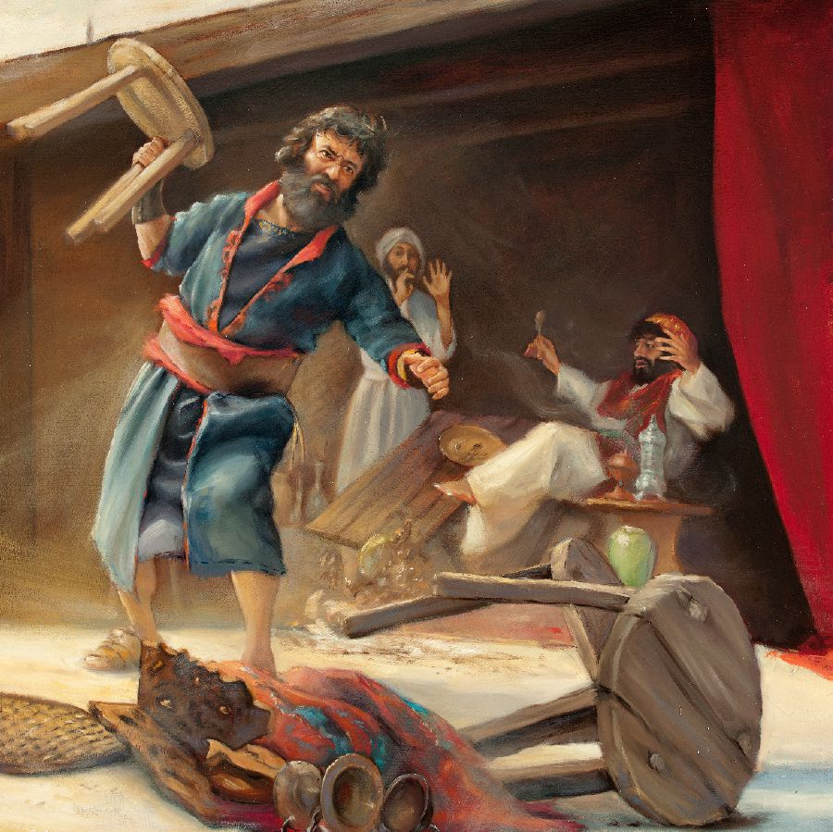
We need to stop compromising over things we know are wrong
Nehemiah Threw Out the Bad
He threw out Tobiah and his belongings
He purged out everything that was foreign
What influences have we allowed into our lives that need to be thrown out?
Notes:
We need to stop compromising over things we know are wrong
He threw out
He threw out Tobiah with all his belongings. He banished Eliashib’s grandson from his presence. He purged out everything that was foreign.
What influences do we have in our own lives that maybe need to be thrown out. Ask yourself a simple question: Does this thing or this person or this place bring me closer to God or take me further away?
Note, I’m not saying we should not mix with the world; but some people, places or practices can be bad influence on us. Remember, make an honest assessment, which is what Nehemiah did near the beginning of this whole story.

Slide 20
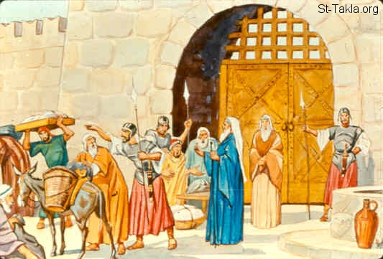
We need to stop compromising over things we know are wrong
Nehemiah Protected the Good
He put back tithes and offerings
He placed guards around the walls
What good things have been lost in your life over time?
Notes:
We need to stop compromising over things we know are wrong
Nehemiah Protected that which was good
Note in throwing out, Nehemiah also, in some cases, replaced what had been thrown out with what was meant to be there in the first place, such as restoring the tithes and offerings. In other cases he placed guards so that the wrong that was being dealt with couldn’t come back again.
What good things have been lost in your life over time? Is it time to restore some of these things, these people, these places, and do we need to protect them? For example, do you place a guard over the time you spend with God? Nehemiah had to re-establish the Sabbath; do we? Do we need to make ourselves accountable to someone else in order to resist falling back into sin?
It’s time for the church, for God’s people, to become distinct from the world again, to show that there is a better way, to clean up its act and to call sin, sin.
NOTE: I know this sounds harsh and “uncompromising”. Surely God wants us to love people, to love the world!!! Yes he does, and we should always be reaching out to those around us and showing them God’s love. But I want to remind us – Nehemiah was trying to clean up the people of God, and what I am saying is that the church also needs to clean up. Only when we are clear ourselves about what is right and wrong will we be able to show the world that there is a better way to live.
How can we show there is a better way, if we are no different to the world around us?
I want to finish by talking about the importance of the Holy Spirit in all of this.

Slide 21
If we want to persevere in the things of God, we need the Holy Spirit
Isaiah 43:18-19
  Forget the former things; do not dwell on the past. ¹⁹ See, I am doing a new thing! Now it springs up; do you not perceive it? I am making a way in the wilderness and streams in the wasteland.
Nehemiah’s generation did not see this new thing
Notes:
If we want to persevere in the things of God, we need the Holy Spirit
I want to take us back to when I introduced the book of Nehemiah and I said that just before all of this took place, Isaiah brought a prophesy. We read it in Isaiah 43:18-19 ¹⁸ Forget the former things; do not dwell on the past. ¹⁹ See, I am doing a new thing! Now it springs up; do you not perceive it? I am making a way in the wilderness and streams in the wasteland.
Nehemiah’s generation did NOT see this new thing. In fact for the next 400 years things remained pretty stale in terms of the things of God, until we Jesus comes and leaves us with his Holy Spirit. The Holy Spirit is the new thing. Joel 2:28 “I will pour out my Spirit on all flesh”, not just the chosen few. Also, in Jeremiah 31:33 we read “This is the covenant I will make with the people of Israel after that time,” declares the LORD. “I will put my law in their minds and write it on their hearts. I will be their God, and they will be my people.
What this story shows me is that with all the best will in the world, we can try and implement reform, but without a radical change from within, we will we will be overcome by the influence of the world, rather than the world be influenced by us for the things of God.
We can only become what God wants us to be, salt and light, a distinct people of God, if we do this in the power of the Holy Spirit.

Slide 22
If we want to persevere in the things of God, we need the Holy Spirit
Jeremiah 6:16
  This is what the Lord says: “Stand at the crossroads and look; ask for the ancient paths, ask where the good way is, and walk in it, and you will find rest for your souls.”
It’s time for the church to return to living in the power of the Holy Spirit – the good way.
Notes:
If we want to persevere in the things of God, we need the Holy Spirit
I said in the very first preach on Nehemiah that perhaps the new thing for us, is actually a return to an old “new thing”. We need to once again reach to God for a fresh indwelling and empowering of the Holy Spirit. He will show us what needs to be put right, and he will give us the means to fulfil those promises we make to him.
Jeremiah 6:16 This is what the Lord says: “Stand at the crossroads and look; ask for the ancient paths, ask where the good way is, and walk in it, and you will find rest for your souls.” I think the church, including NLC is at a crossroads and we need to choose which way we are going to go? Are we going to choose the “good way”.
Let’s not be like the nation of Israel in Nehemiah’s time who did so well in coming out of their lockdown, only to drift back into the very things that took them into lockdown in the first place. Let’s be like the early church who embraced the new thing, the Holy Spirit, and let’s change the world around us, starting firstly with our own house, and then spreading out to the communities he has placed us in.

